Slide 1
Fan engagement portal
TEAM BYTE BUILDERS:
P K TASMIYA – 3BR23EC114
PRAVALIKA JOSHI – 3BR23EC127
TEHESHEEN TASNEEM – 3BR23EC165
V YASHASWINI – 3BR23EC177

Slide 2
INTRODUCTION
A fan engagement portal is a dedicated platform designed to connect fans with their favorite teams, artists, or brands.
It serves as a hub for interactive content, exclusive updates, merchandise, and community forums.
By fostering two-way communication, these portals enhance fan experiences through personalized interactions, loyalty programs, and access to behind-the-scenes content.
The goal is to deepen the relationship between fans and their passions, driving engagement and loyalty.

Slide 3
Problem statement
Struggles to maintain consistent and meaningful engagement with their fans.
Fan interaction such as social media and live events lack personalization.
Needs more interaction with fans personally.
Time consuming if done manually.

Slide 4
OBJECTIVES
Enhance Fan Experience: Provide fans with a personalized and interactive experience that deepens their connection with the team, artist, or brand .
Increase Engagement: Offer exclusive content, live interactions, and community features to keep fans actively involved and engaged .
Build a Community: Create a space where fans can connect, share, and interact with each other, fostering a sense of belonging and loyalty .
Provide Exclusive Access: Offer behind-the-scenes content, early access to tickets, or special events to reward fans and encourage participation.
Enhance Brand Loyalty: Strengthen the relationship between fans and the brand by offering unique and engaging experiences that resonate emotionally.

Slide 5
ALGORITHM
Collect user data: name, age, location, favorite teams, players, genres, etc . Use preferences to create a personalized dashboard.
Content Recommendation System : Implement a recommendation engine using collaborative filtering, content-based filtering, or hybrid models.
Engagement Scoring : Assign scores to various engagement actions .Create a fan level or badge system to reward active users
Social Interaction Mechanism : Enable features like comments, direct messaging, and live chat .
Implement gamification features like polls, quizzes, and trivia with rewards or points .

Slide 6
Module split up
CREATE: The program allows users to create fan details and record their comments.
DELETE : The program includes the ability fan details from the list
UPDATE: The program automatically updates the list when other fan details are added.
DISPLAY: The program displays the current details and comment of all fans.

Slide 7
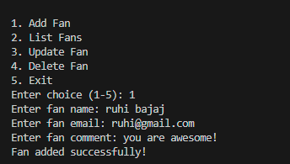
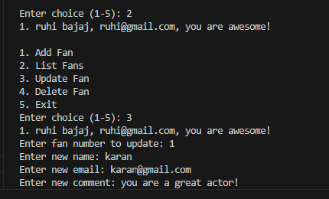
result

Slide 8
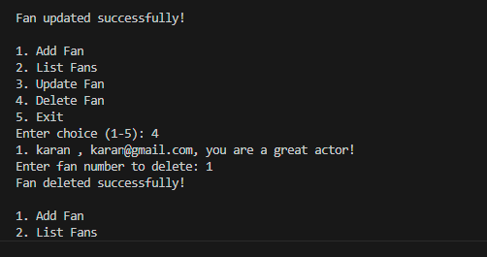
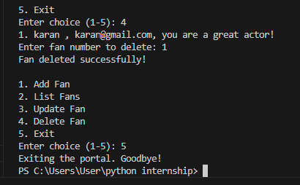

Slide 9
conclusion
conclusion, a fan engagement portal is a vital tool for building strong connections between fans and their favorite teams or brands. By providing a centralized space for interaction, exclusive content, and community involvement, these portals enhance the overall fan experience. Ultimately, they foster loyalty, drive engagement, and create a thriving ecosystem where fans feel valued and invested in their passions. As technology continues to evolve, such platforms will play an increasingly important role in shaping the future of fan engagement.

Slide 10
Future enhancement
Live chat and Q&A with their favourite actor, sports person or players.
Enhanced social features and gamification.
Real time engagement tools.

Slide 11


